Slide 1




FitMate
Team ID - 10574
Team Leader-
Patel Nishil Vijaybhai

Slide 2

Project Objectives
Problem Statement
Project Overview – Introduction
End Users
Wow Factor in Project
Modelling/Block Diagram/Flow of Project
Result/outcomes
Conclusion
Future Perspective

Slide 3
Problem Statement
Many fitness enthusiasts struggle with maintaining the correct form while working out at home or in the gym without any professional supervision. Incorrect form can often lead to ineffective workouts, injuries, and poor muscle engagement.
Challenges:
1. Poor Body Posture while exercising
2. No real-time Feedback
3. No automatic rep/set count
4. Inaccesibility of Supervision
Real-life Examples
Home gymers often tend to stick to same exercise routine with bad form and either end up with no muscle hypertrophy or injuries.
Unavailability of Trainers in gym, often leads to people performing heavy weight machine exercises with terrible form which increases the chance of Injuries.

Slide 4
Project overview - Introduction
FitMate is a web-based AI-driven fitness assistant that analyzes users's bofy form in real-time using computer vision and leverages body lanmarks to deduce the correct body posture required for an exercise and provides feedback to improve incorrect posture.
Key Features
Detects body posture in real-time to allow the assistant to analyze body form.
Automatically counts legal and complete reps along with up/down status signals.
Immediately provides visual feedback along with audio warnings.
Multiple excersize support at a single place with a single click.
How does it Operate
UserInput:Takes live user webcam feed as persistent input.
Mapping:Generates Landmarks over user’s body for detecting pose.
Calculation:Calculates angles and performs for form analyses.
Feedback:Provides feedback upon completion of analysis.
Goals Achieved
Maintain Good Form
Reduce Injury risks
Track per set progress
Enhances home workout experience

Slide 5
End User
Home Workout Enthusiasts
Individuals exercising without trainers need form support
Form Correction on the spot to avoid persistent incorrect form.
Gym Trainers
Trainers with multiple clients can utilize this app to guide clents during unavailability.
Strict Automated counter will help them to ensure client doesnt cheat in their absense.
Classic Gymer
Gym-goers who don’t want to pay for private Trainers can utilize it to ensure correct form even without supervision of a trainer.
Online Fitness Trainers
Trainers that provide online coaching can leverage it to improve their client’s productivity.
Rehabilitation Patients
Individuals going through recovery phase can leverage this assistant to track their muscle recovery and form changes.

Slide 6
Wow Factor in Solution
Real-Time Feedback
The System detects incorrect form and gives instant feedbacks.
Feedbacks are in the form of both audio and visual(text-based) form.
Pose Estimation with MediaPipe
Uses Advanced human pose detection to locate and track landmarks of the human body.
Landmark analyses help calculate various body angles
Dynamic Rep Counter
Automatically increments the counter for each legal full cycle rep.
Pauses when incorrect form is detected.
Error Correction for multiple exercises
Distinct Error identification and Feedback for different type of exercises.
Variation in some exercises is also considered legal Eg.Straight Arm Plank,Forearm Plank etc.
Compatability
Works on nearly every webcam.
Web based accessibility

Slide 7
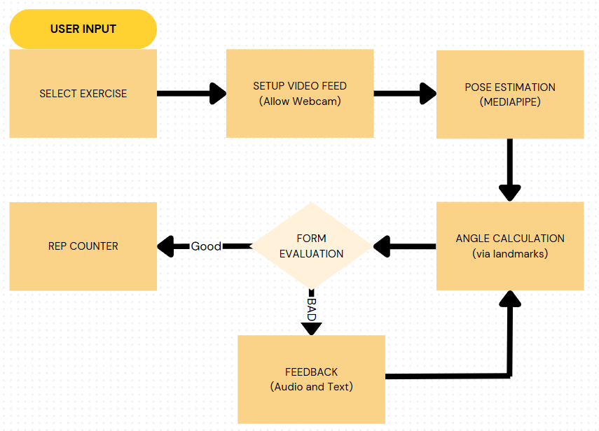
Modelling

Slide 8
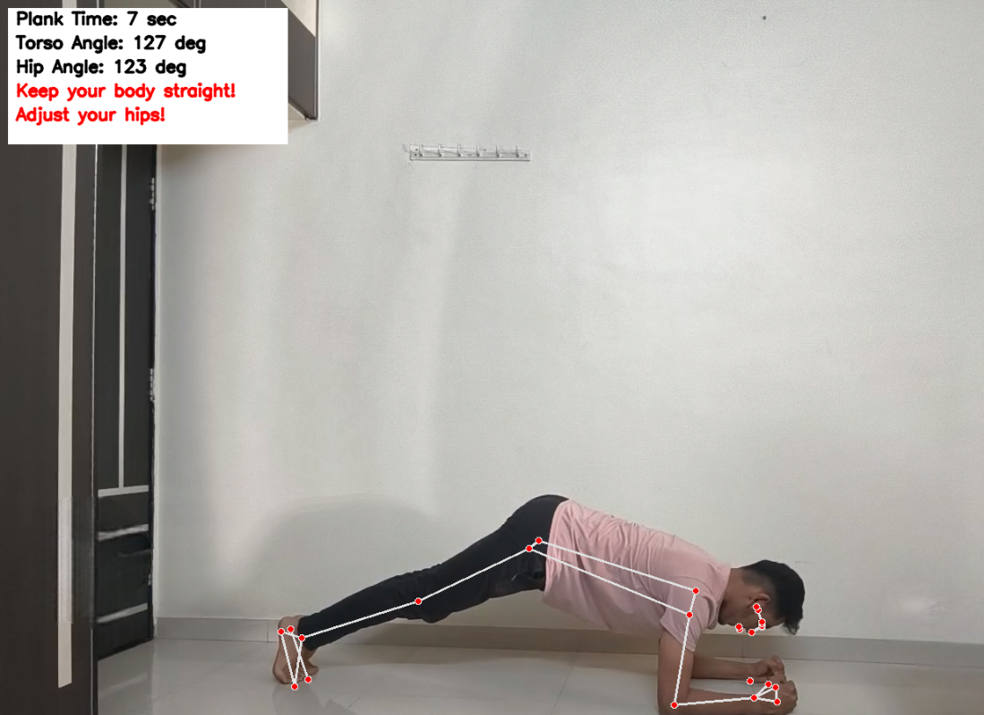
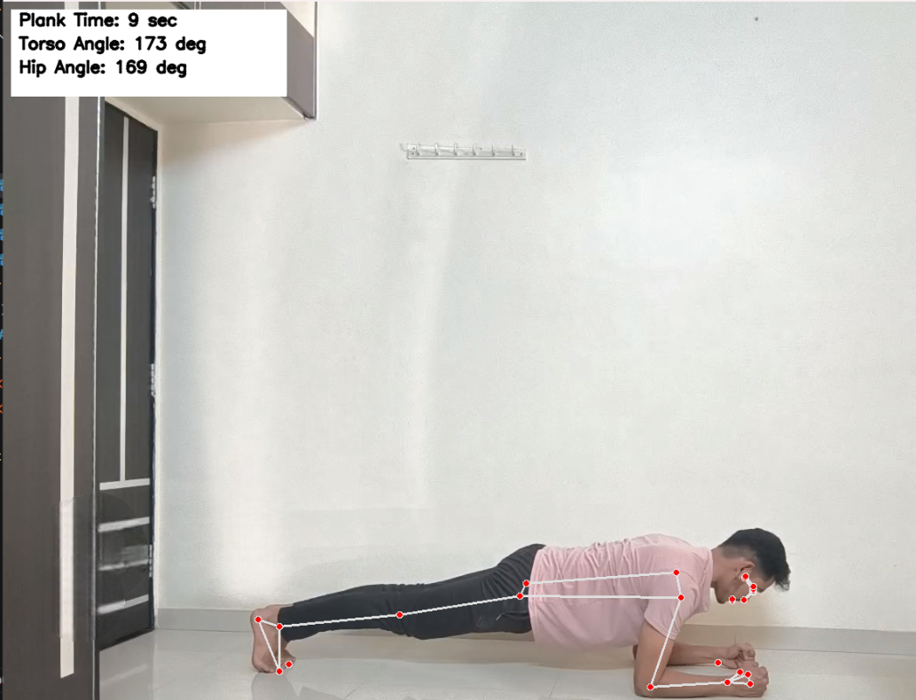
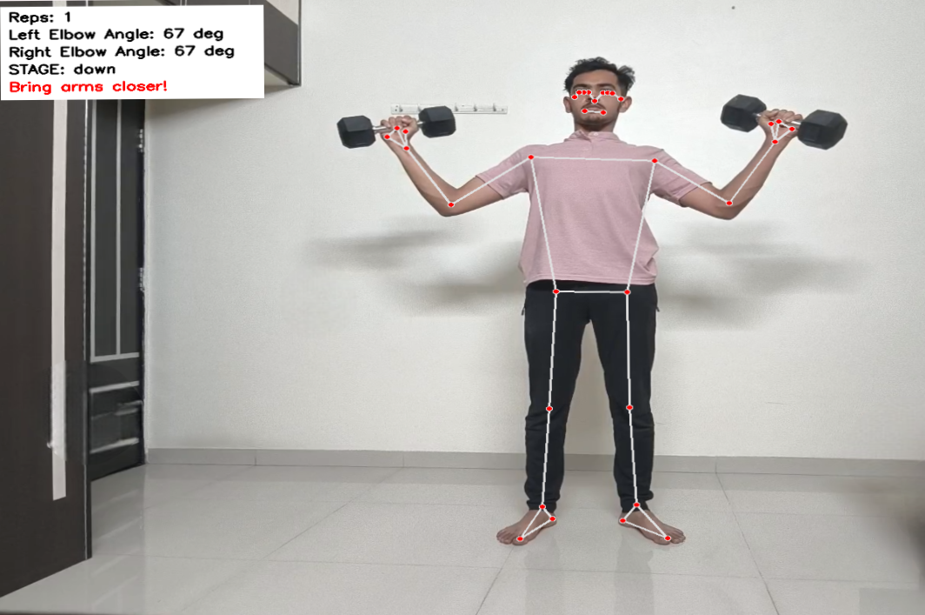
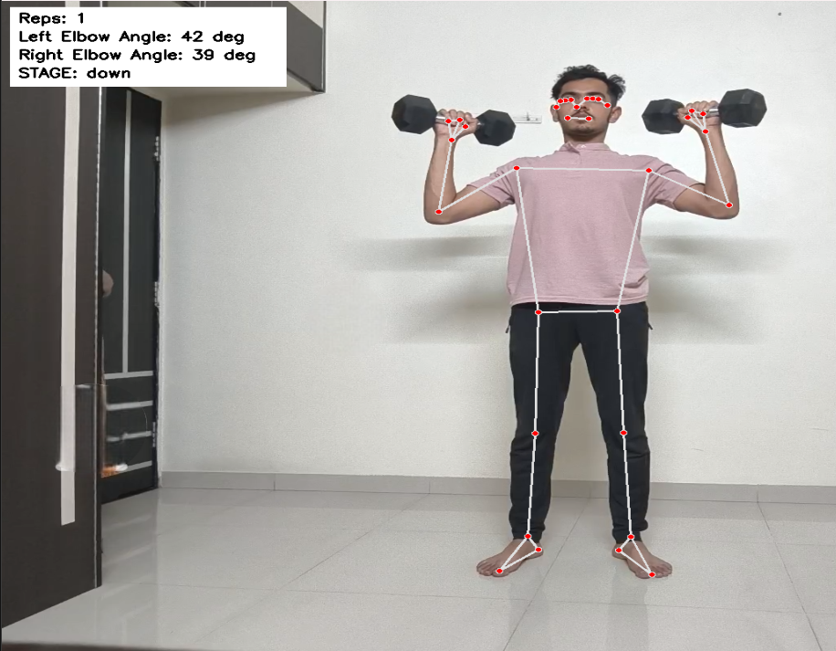
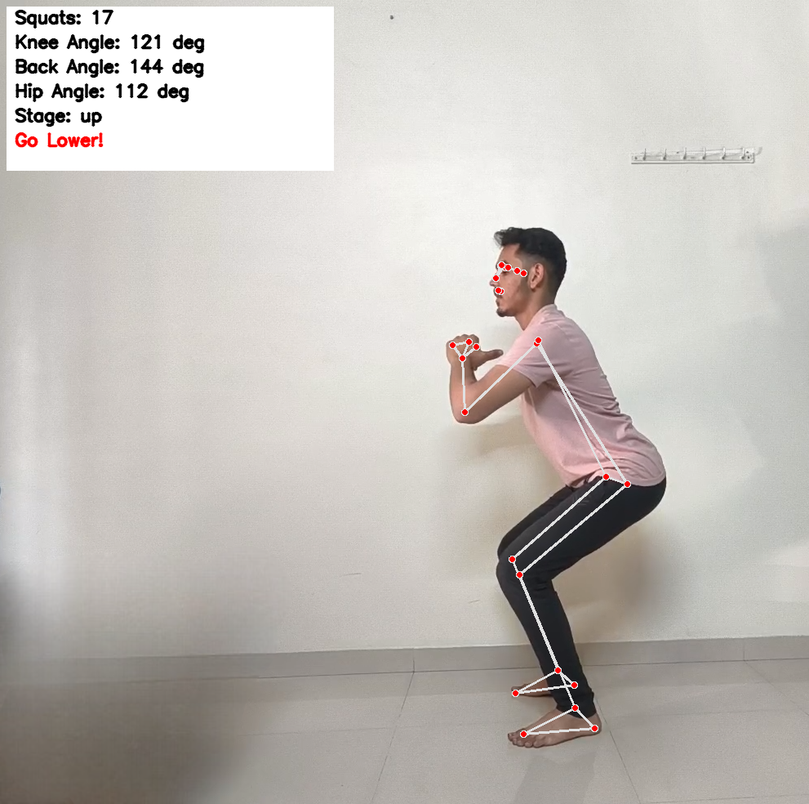
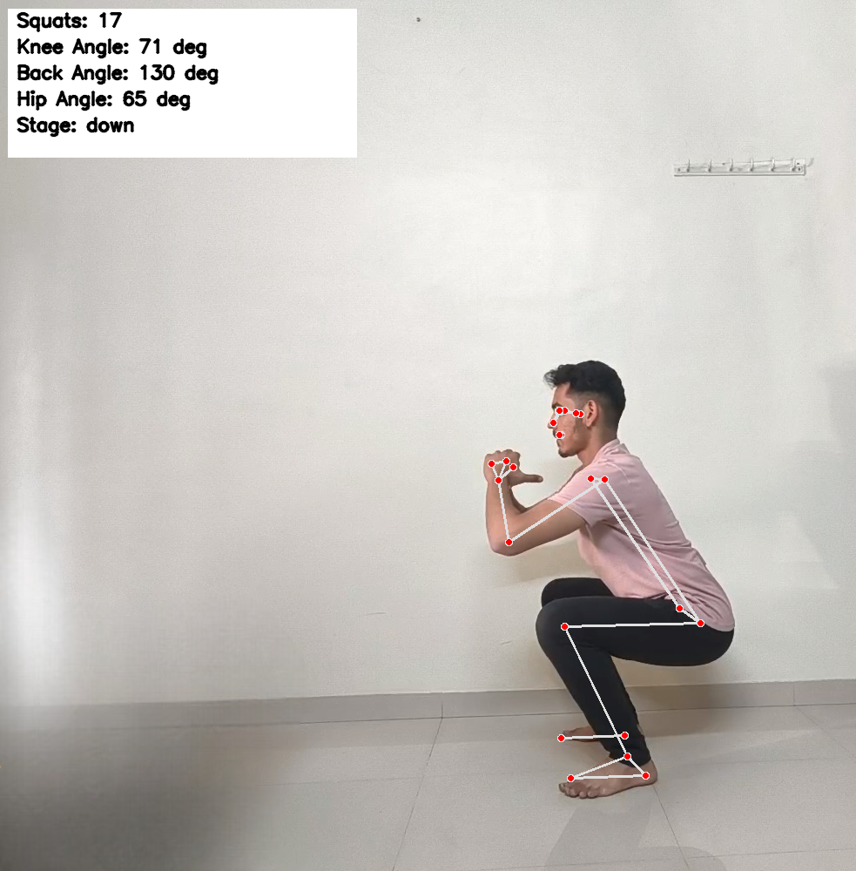
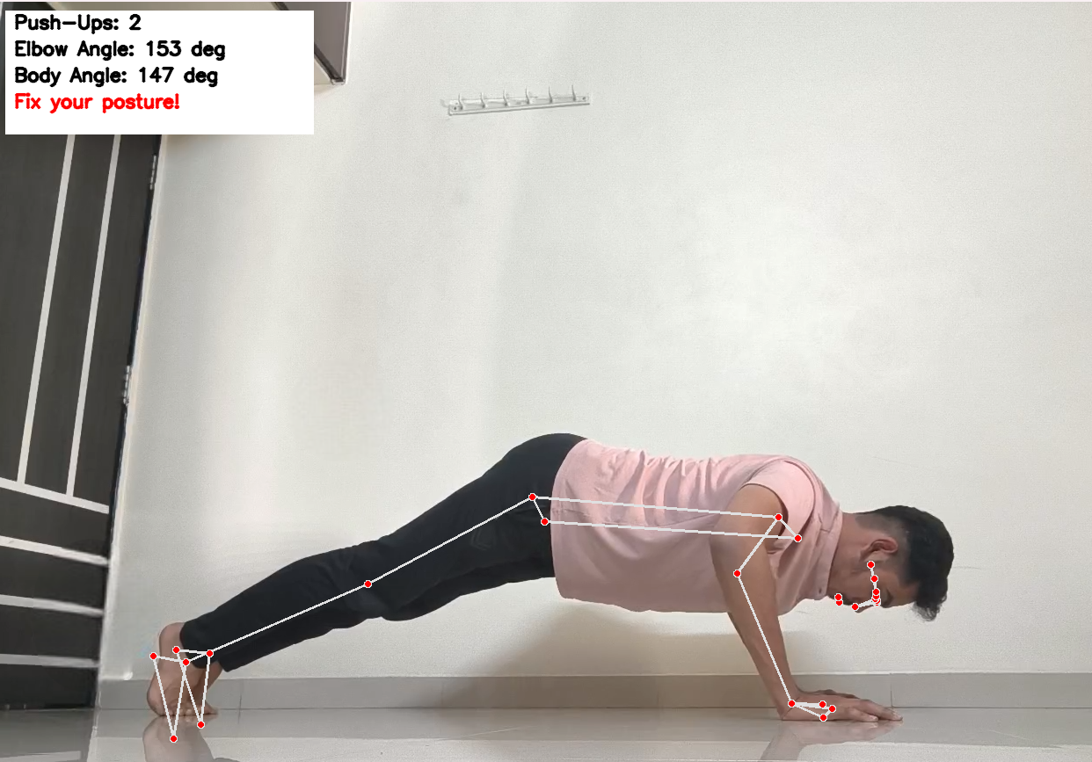
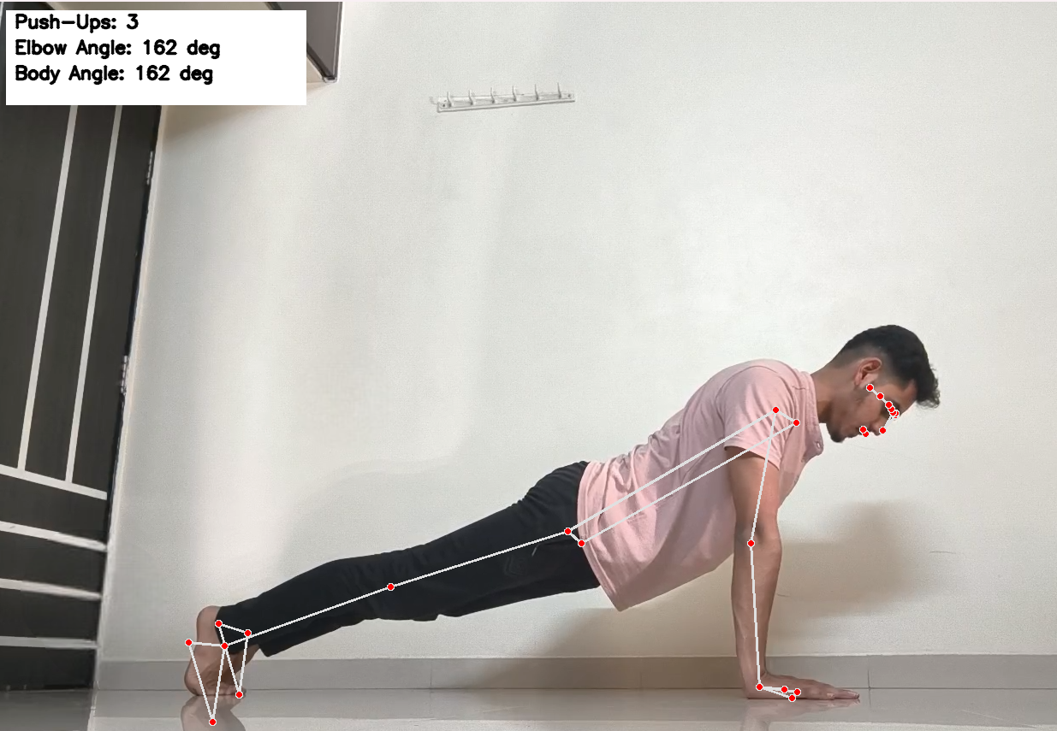
Result / Outcomes
INCORRECT FORM
CORRECTEDForm
INCORRECT FORM
INCORRECT FORM

Slide 9
Conclusion
From the foreseen information, we can conclude that People who perform exercises on their own i.e in isolation or without any professional supervision, can leverage FitMate to analyze their body form in real-time while also receiving live feedback which will help them perform exercise with better form and avoid injury risks. Moreover the simple design and lightweight system can be utilized to enhance workout experience even when without additional utilities or seemingly good device ie. PC or Computer to operate on.
Key Takeaways
FitMate Successfully detects and corrects exercise form using MediaPipe
Provides accurate posture analysis and rep counting.
Offers real-time audio and visual feedback which helps users to improve posture on the spot.
Numerous Exercises can be easily integrated to adhere to user needs.
Lightweight,fast and can easliy function at mere 25-30 fps ,giving seamless experience.

Slide 10
Future Perspective
A Good number of Features and Functionalities can be added in future updates
AI-Powered form checking - Deep-learning models can be used along with geometrical tracking to further increase the detection accuracy
Data-Driven Progress Tracking - Machine learning model can be utilized to track user’s progress in maintaing form throughout a long period and areas of error can be deduced from it.
Gamification - Combining workouts with games i.e. Integrating games that simulate exercise patterns. This would help enhance user’s interest and involvement in workout.
Multi-Excercise Exapansion - A vast number of exercise can be added to provide users with a variety of options to choose from.
Personalized Training- The Data driven progress tracking that we saw above can be further used to create personalized workout plans for users according to their workout patterns.

Slide 11
Thank you...!

